Slide 1


Unit 3
Introduction to HHFA data review, interpretation and communication
Notes:
Welcome to Unit 3, an introduction to HHFA data review, interpretation and communication.

Slide 2
By the end of this unit, you will:
outline HHFA data processing and analysis
summarize HHFA data review and description
outline HHFA data interpretation and communication
Notes:
By the end of this unit, you will:
outline HHFA data processing and analysis;
summarize HHFA data review and description; and
outline HHFA data interpretation and communication.

Slide 3
HHFA data review, interpretation and communication
HHFA key steps:
1
2
3
4
5
5
6
6
7
Decide information needs
Adapt questionnaire & CSPro tool
Train data collectors
Collect data
Analyse data
Analyse data
Interpret, communicate & use
Interpret, communicate & use
Curate data
Plan, prepare and manage (detailed activities)
Notes:
In this course, we will look at steps 5 and 6 in the 7 key steps of the HHFA.
This will involve examining the detailed planning and management activities that support these two key steps.

Slide 4
HHFA data review, interpretation and communication
HHFA detailed planning and management activities:
A
D
Data review and description
Planning and preparation
B
E
Data interpretation and communication
Data collection
C
Data processing and analysis
F
Data curation
Notes:
The HHFA detailed planning and management activities include 6 phases.
In this course, we will look at the following phases:
Phase C: Data processing and analysis;
Phase D: Data review and description; and
Phase E: Data interpretation and communication.

Slide 5


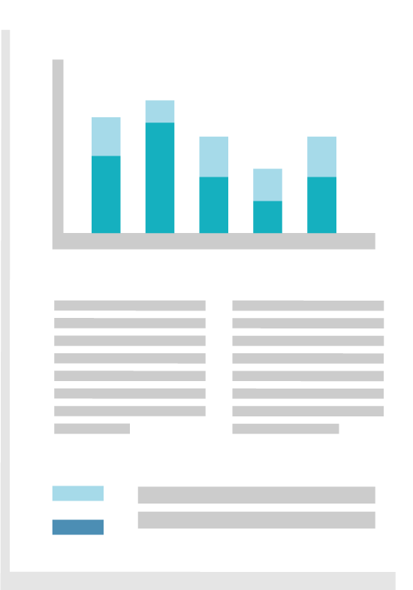

Phase C: Data processing and analysis
A
D
Data review and description
Planning and preparation
data collection complete
data cleaned in CSPro
data analysis platform
standard analysis outputs
B
E
Data interpretation and communication
Data collection
C
Data processing and analysis
F
Data curation
Notes:
Let’s start with Phase C: Data processing and analysis.
Once HHFA data collection is complete, the data are checked and cleaned within CSPro.
The final data set is then uploaded to the HHFA data analysis platform.
The platform automatically calculates the HHFA indicators, and displays them in tables and graphs - the standard analysis platform outputs.

Slide 6
Phase D: Data review and description
Review of the data analysis platform outputs involves three stages:
A
D
Data review and description
Planning and preparation
1
Understanding the structure of the tables and graphs
B
E
Data interpretation and communication
Data collection
2
Understanding what the data reveal
Data processing and analysis
C
3
F
Describing and summarizing the initial findings
Data curation
Notes:
After the data analysis outputs have been produced, Phase D: Data review and description, can commence.
The initial review of the data analysis platform outputs involves three stages:
Understanding the structure of the tables and graphs;
Understanding what the data reveal; and
Describing and summarizing the initial findings.

Slide 7
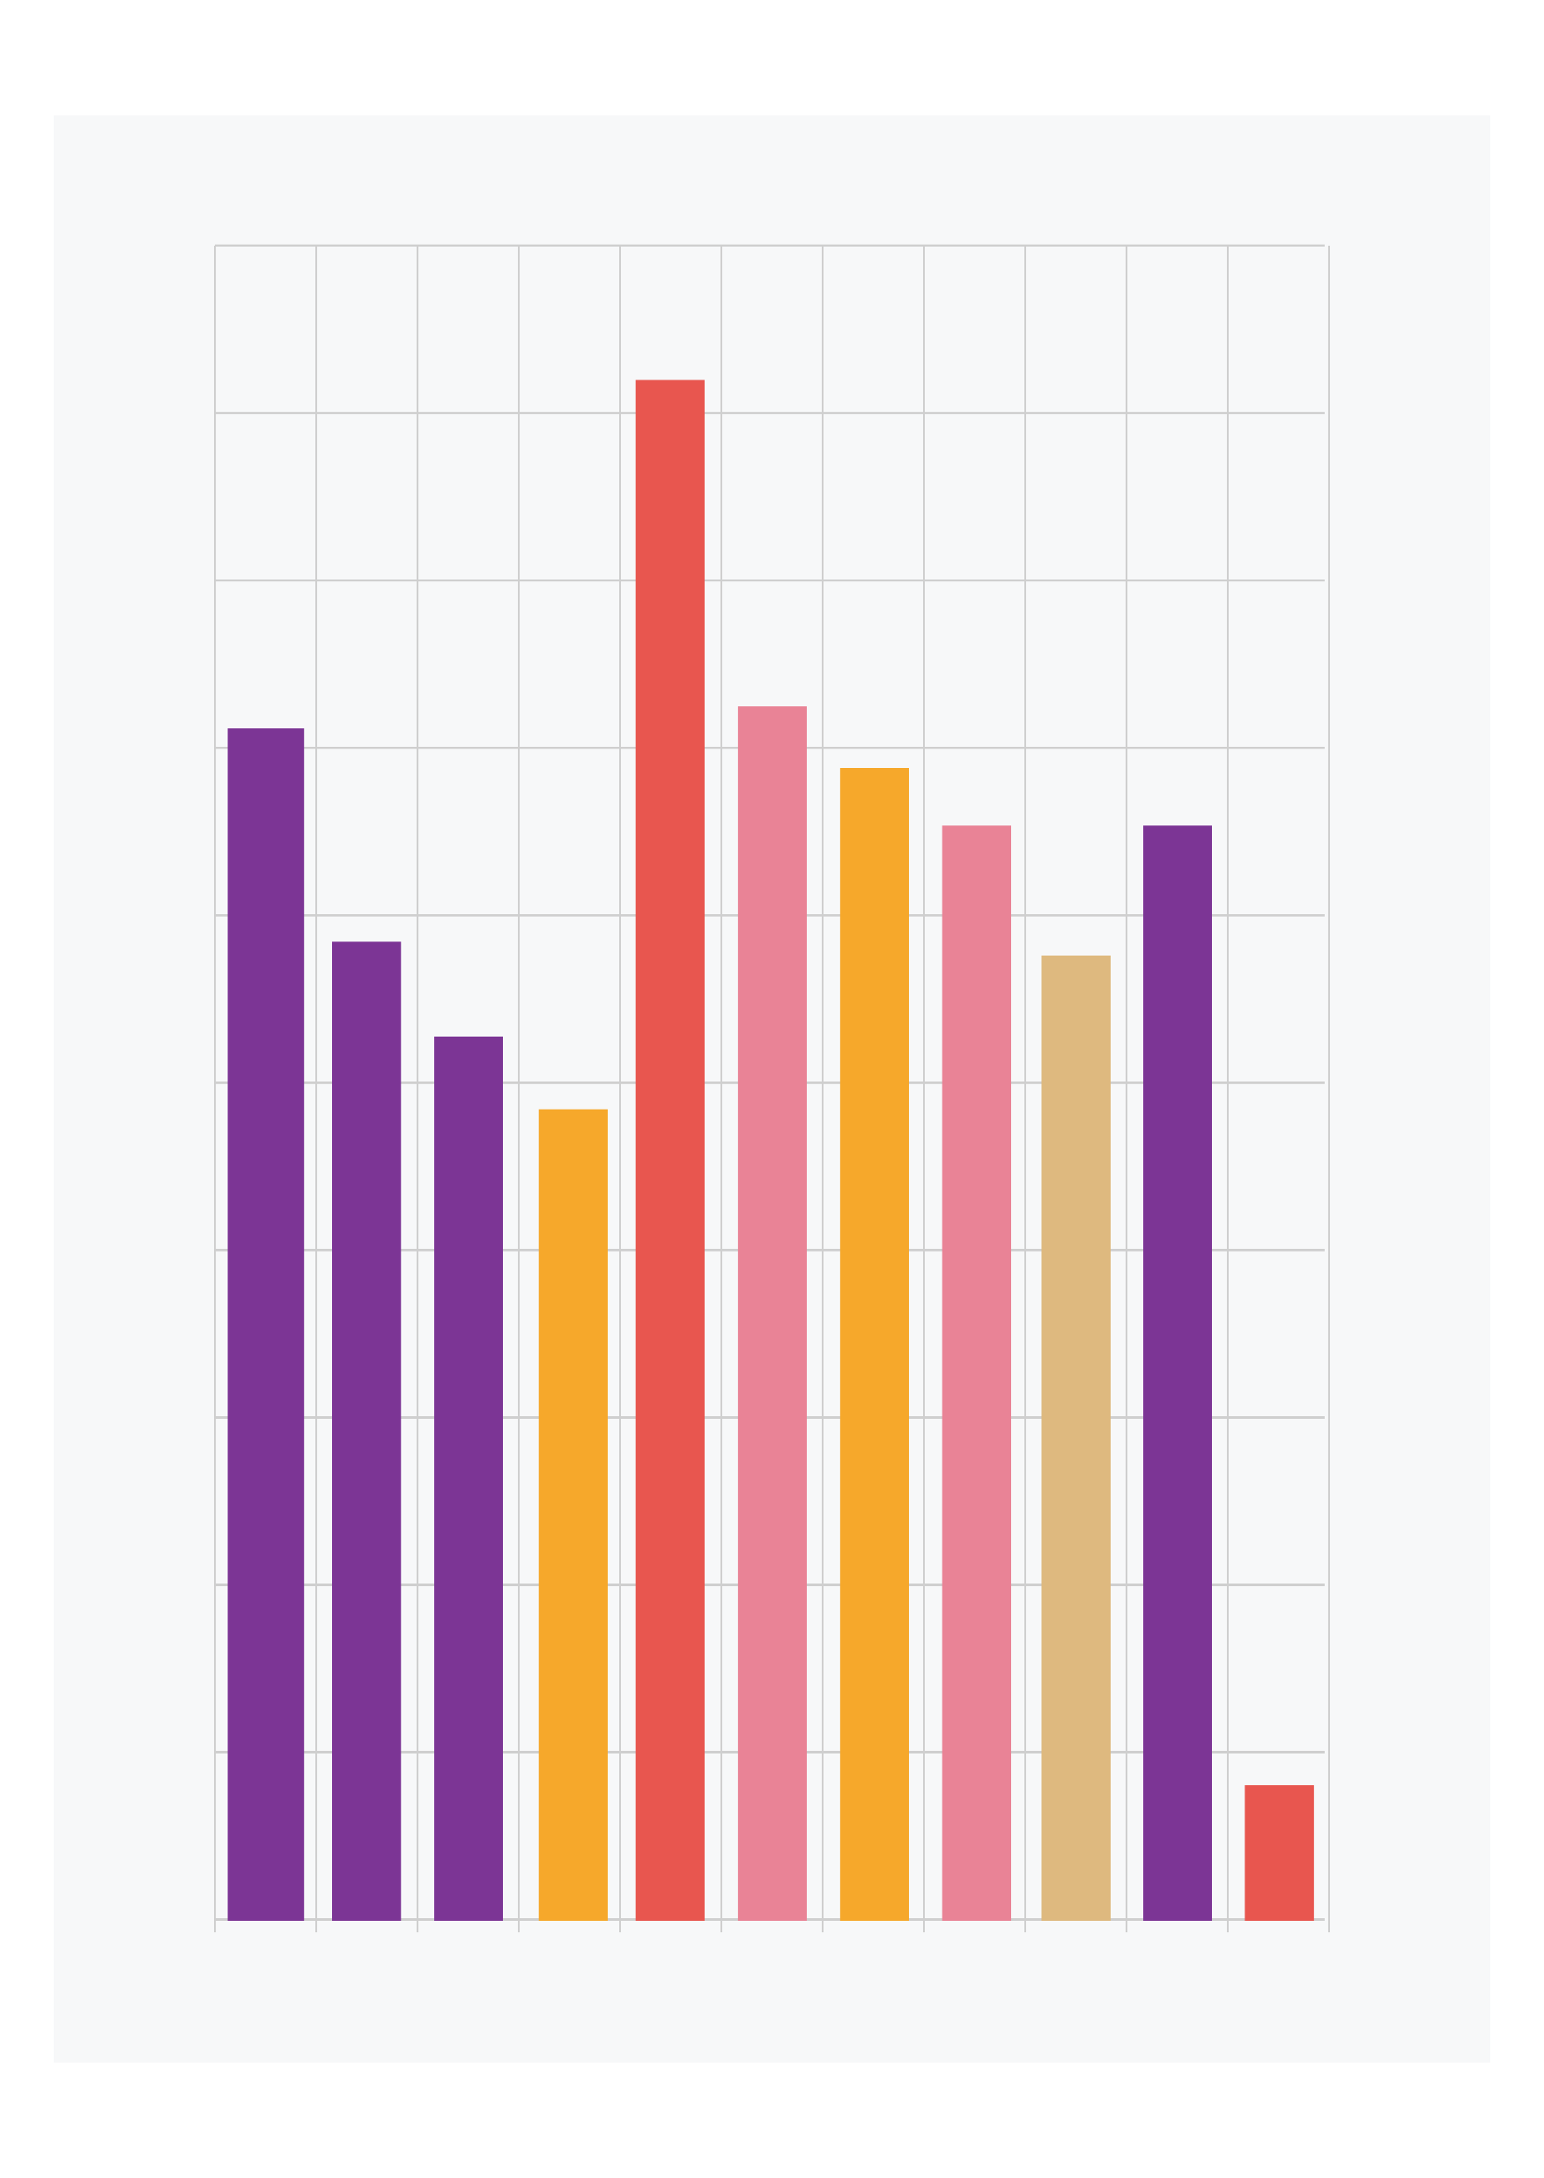
Phase E: Data interpretation and communication
A
D
Data review and description
Planning and preparation
Data interpretation aims to understand:
B
E
Data interpretation and communication
Data collection
what the data mean in the country context
the reasons behind the findings
C
Data processing and analysis
F
Data curation
Notes:
Following the initial review and description of the analysis platform outputs, we proceed to Phase E: Data interpretation and communication.
The aim of data interpretation is to help us understand what the HHFA data mean within the country context, and to explore the reasons behind the findings.

Slide 8
Phase E: Data interpretation and communication
Data review
Data
interpretation
cycle
Further data analysis
Use of contextual information
Consultation with experts
Data triangulation
Notes:
Interpretation of HHFA data involves an iterative cycle of:
data review and description;
use of contextual information;
triangulation of HHFA data with data from other sources and methods;
consultations with experts; and
further analysis of the data, as needed.

Slide 9
Data interpretation
Data review
Data
interpretation
cycle
Further data analysis
Use of contextual information
Findings, with explanations
Conclusions
Priorities
Recommendations
Consultation with experts
Data triangulation
Notes:
The interpretation cycle should result in findings, along with their explanations, that will lead to conclusions, identification of priority issues, and recommendations, which will form the basis of the main HHFA report.

Slide 10

Phase E: Data interpretation and communication
Communication of HHFA findings
Use of HHFA data
Improvement of health facility sevices
Notes:
The HHFA findings and recommendations must then be communicated to all stakeholders, so that the data can be used for decision-making to improve health services. This is the ultimate goal of the HHFA.

Slide 11
You have now completed Unit 3.
The next unit will look at the organization of a country data review and interpretation process.
Notes:
You have now completed Unit 3.
In the next unit, we will look at the organization of a country HHFA data review and interpretation process.

